Slide 1
Introduction to Sockets (part 2)
IP, ICMP, UDP, TCP header format, servers, byte ordering, socket file descriptors, POSIX data types and functions, useful tools
Chapters 1,2 and 3.

Slide 2
Summary
Overview of Networking
Host
Router
Layer 2 – 3 – Interaction
Overview of Transport protocols

Slide 3
Bits, Bytes and Words
Definitions
Bit = Binary digit = 0 or 1
Byte = a sequence of 8 bits = 00000000, 00000001, ..., or 11111111
Word = a sequence of N bits where N = 16, 32, 64 depending on the computer

Slide 4
and on Architectures
8/16/32/64/128/256-bit
8/16-bit Arch; IoT, sensors, etc…
32-bit Arch; old computers (~2005), larger sensors/gateways…
64-bit Arch; current computers

Slide 5

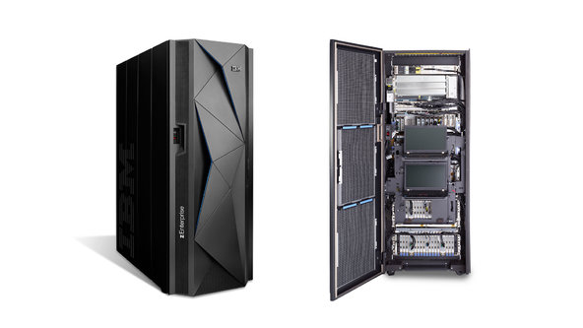
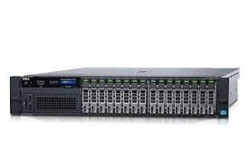
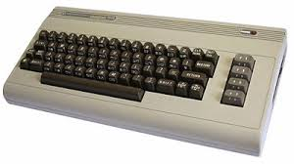
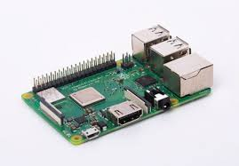
Bit/Byte – Arch – Communications
Intel Xeon 4110 2.1GHz
64-bit
Intel 6510/8500 1Mhz
8-bit

Slide 6
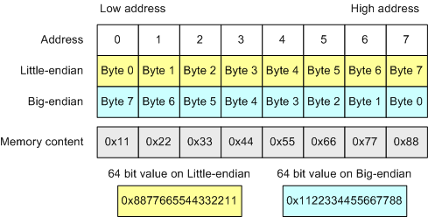
Byte Ordering

Slide 7
Byte Ordering
Host
ntohl()
ntohs()
Network
htonl()
htons()

Slide 8

Never Assume….
Network Byte order!
Data Types -- Architecture!
Int = Integer = ? Bits
Signed / Unsigned?
ASCII
UTF8/16/32
+01dl
+10dl

Slide 9
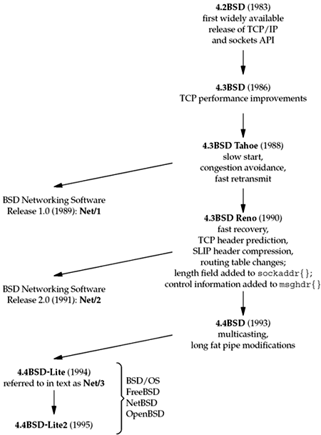
Sockets
BSD Sockets
POSIX Sockets
Linux Sockets
Unix Sockets
Datalink Sockets
Storage Sockets
Windows Sockets

Slide 10
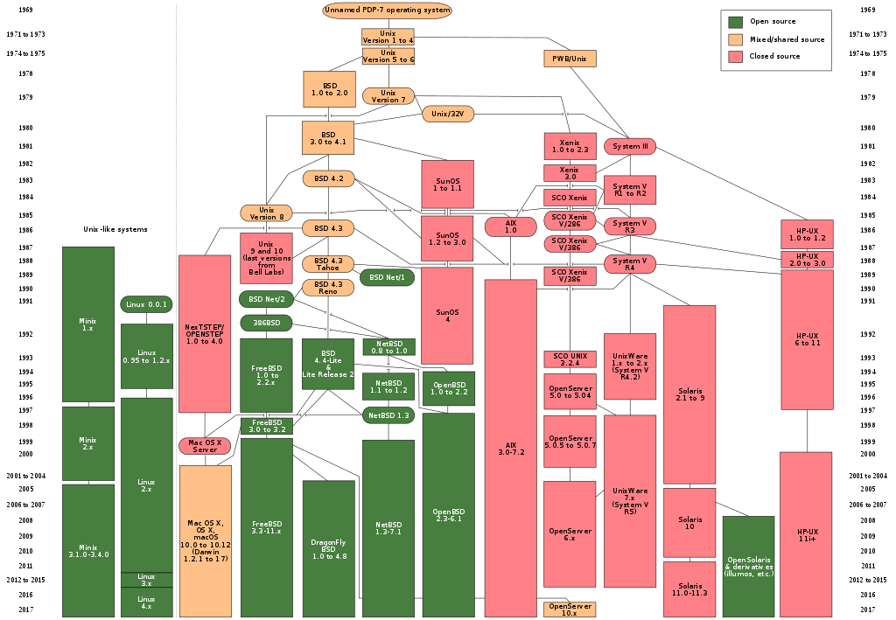

Slide 12
POSIX
Portable Operating System Interface; IEEE 1003.1
Maintaining compatibility between operating systems.
Basic Reuse
Application Programming Interface
Command line shells, utilities, etc..

Slide 13
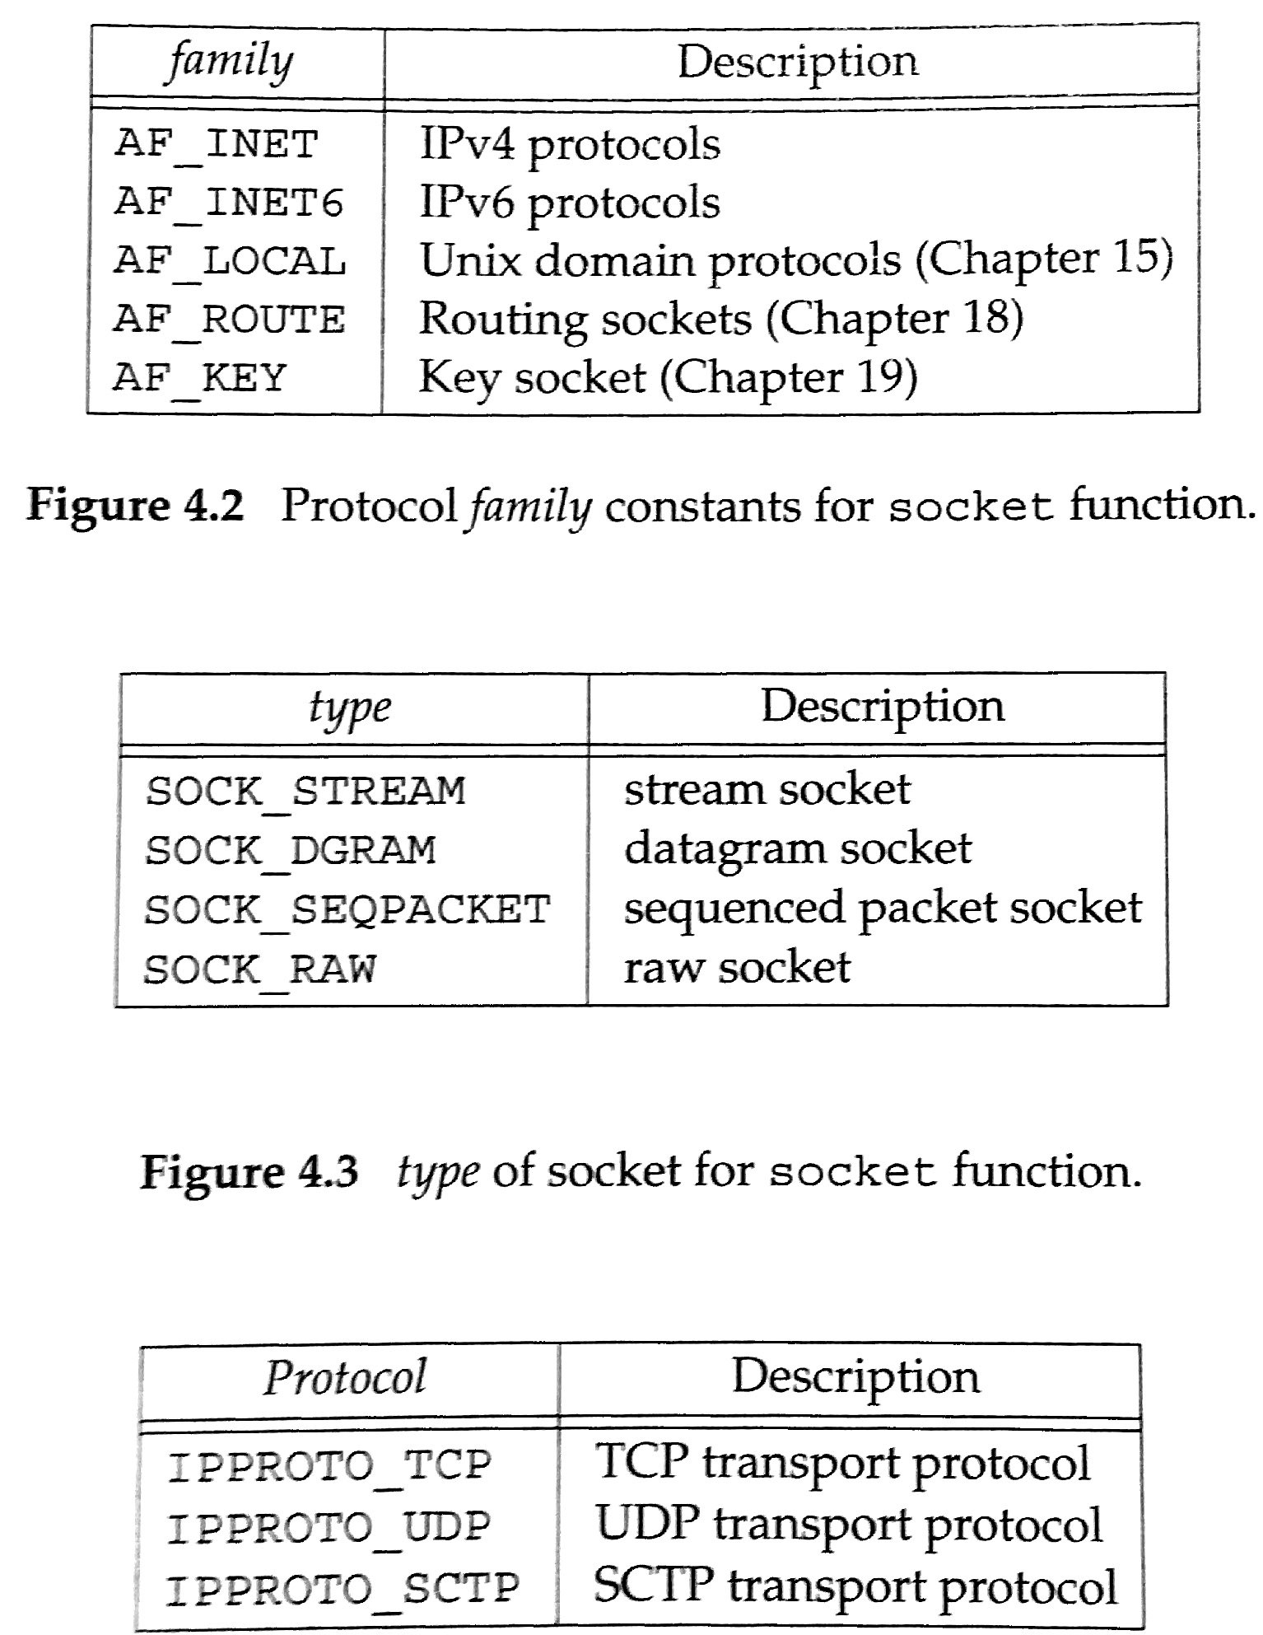
Socket
#include <sys/socket.h>
int socket(int family, int type, int protocol);
On Success, returns a non-negative integer, a socket descriptor.
#include <sys/types.h>
#include <sys/socket.h>
int socket(int domain, int type, int protocol);
Domain
AF_UNIX
AF_LOCAL
AF_INET
AF_INET6
AF_IPX
AF_NETLINK
AF_X25
AF_AX25
AF_ATMPVC
AF_APPLETALK
AF_PACKET
Type
SOCK_STREAM
SOCK_DGRAM
SOCK_SEQPACKET
SOCK_RAW
SOCK_RDM
SOCK_PACKET
Protocol
/etc/protocols
Not all combinations work

Slide 14
Example: UDP and TCP Sockets
…
if((s=socket(AF_INET, SOCK_DGRAM, IPPROTO_UDP)) == -1 ){
die(“Socket Error”);
}
…
UDP
if((s=socket(AF_INET, SOCK_DGRAM, 0)) == -1 ){
die(“Socket Error”);
}
…
if((s=socket(AF_INET, SOCK_STREAM, IPPROTO_TCP)) == -1 ){
die(“Socket Error”);
}
…
TCP
if((s=socket(AF_INET, SOCK_STREAM, 0)) == -1 ){
die(“Socket Error”);
}

Slide 15
IPv4 Socket Address Structure
struct sockaddr_in {
uint8_t sin_len; /* length of structure (16) */
sa_family_t sin_family; /* address family: AF_INET */
in_port_t sin_port; /* port in network byte order */
struct in_addr sin_addr; /* internet address */
char sin_zero[8];/* unused */
};
/* Internet address. */
struct in_addr {
in_addr_t s_addr; /* address in network byte order */
};
required
Linux / POSIX
struct sockaddr_in {
sa_family_t sin_family; /* address family: AF_INET */
in_port_t sin_port; /* port in network byte order */
struct in_addr sin_addr; /* internet address */
};
/* Internet address. */
struct in_addr {
uint32_t s_addr; /* address in network byte order */
};

Slide 16
Datatypes
Datatype | Description | Header
int8_t | Signed 8-bit integer | <sys/types.h>
uint8_t | Unsigned 8-bit integer | <sys/types.h>
int16_t | Signed 16-bit integer | <sys/types.h>
uint16_t | Unsigned 16-bit integer | <sys/types.h>
int32_t | Signed 32-bit integer | <sys/types.h>
uint32_t | Unsigned 32-bit integer | <sys/types.h>
sa_family_t | Address family of socket address structure | <sys/socket.h>
socklen_t | Length of socket address structure, normally uint32_t | <sys/socket.h>
in_addr_t | IPv4 address, normally uint32_t | <netinet/in.h>
in_port_t | TCP or UDP port, normally uint16_t | <netinet/in.h>

Slide 17
Generic Socket Address
struct sockaddr {
uint8_t sa_len;
sa_family_t sa_family; /* address family: AF_xxx value */
char sa_data[14]; /* protocol specific */
};
Linux / POSIX
struct sockaddr {
sa_family_t sa_family; /* address family: AF_xxx value */
char sa_data[14]; /* protocol specific */
};

Slide 18
Type Casting
int bind(int, struct sockaddr *, socklen_t)
struct sockaddr { uint8_t sa_len; sa_family_t sa_family; /* address family: AF_xxx value */ char sa_data[14]; /* protocol specific */ };
struct sockaddr_in serv;
bind(sockfd, (struct sockaddr*) &serv,sizeof(serv)
struct sockaddr_in {
uint8_t sin_len; /* length of structure (16) */
sa_family_t sin_family; /* address family: AF_INET */
in_port_t sin_port; /* port in network byte order */
struct in_addr sin_addr; /* internet address */
char sin_zero[8];/* unused */
};

Slide 19
Example: Type Cast
…
struct sockaddr_in address;
address.sin_family = AF_INET;
address.sin_addr.s_addr = INADDR_ANY;
address.sin_port = htons( PORT );
…
if (bind(server_fd, (struct sockaddr *)&address, sizeof(address))<0) {
…
struct sockaddr { uint8_t sa_len; sa_family_t sa_family; char sa_data[14]; };
struct sockaddr_in {
uint8_t sin_len;
sa_family_t sin_family;
in_port_t sin_port;
struct in_addr sin_addr;
char sin_zero[8];
};

Slide 20
IPv6 Socket Address Structure
struct sockaddr_in6 {
uint8_t sin6_len; /* length of structure (28) */
sa_family_t sin6_family; /* address family: AF_INET6 */
in_port_t sin6_port; /* port in network byte order */
uint32_t sin6_flowinfo; /* flow information, undefined */
struct in6_addr sin6_addr; /* IPv6 address */
uint32_t sin6_scope_id; /* set of interfaces for a scope */
};
/* Internet IPv6 address. */
struct in6_addr {
uint8_t s6_addr[16]; /* 128-bit IPv6 address, network byte order */
};

Slide 21
Summary
Bits, Bytes and Words
POSIX / Linux
Socket
Datatypes
Sockaddr
Type Casting

Slide 22
Value – Result Arguments
User process
int
Socket address structure
length
bind()
connect()
sendto()
value
protocol
address
Kernel

Slide 23
Value – Result Argument
User process
int*
Socket address structure
length
accept()
recvfrom()
getsockname()
getpeername()
value
result
protocol
address
Kernel

Slide 24
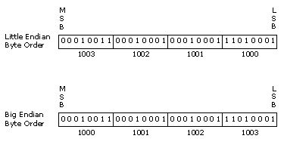
Byte Ordering (repeat)
Increasing memory address
Host byte order
Increasing memory address

Slide 25
Byte Ordering Functions
#include <netinet/in.h>
/* Host to Network short||long */
uint16_t htons(uint16_t host16bitvalue);
uint32_t htonl(uint32_t host16bitvalue);
/* Network to Host short||long */
uint16_t ntohs(uint16_t net16bitvalue);
uint32_t ntohl(uint32_t net16bitvalue);

Slide 26
Reading Protocol Defs.
0 1 2 3
0 1 2 3 4 5 6 7 8 9 0 1 2 3 4 5 6 7 8 9 0 1 2 3 4 5 6 7 8 9 0 1
+-+-+-+-+-+-+-+-+-+-+-+-+-+-+-+-+-+-+-+-+-+-+-+-+-+-+-+-+-+-+-+-+
|Version| IHL |Type of Service| Total Length |
+-+-+-+-+-+-+-+-+-+-+-+-+-+-+-+-+-+-+-+-+-+-+-+-+-+-+-+-+-+-+-+-+
| Identification |Flags| Fragment Offset |
+-+-+-+-+-+-+-+-+-+-+-+-+-+-+-+-+-+-+-+-+-+-+-+-+-+-+-+-+-+-+-+-+
1
2
First bit 0 is transmitted, then 1, 2,….. 31, (next line), 32, 33,…..

Slide 27
Byte Manipulation Functions
#include <string.h>
/* ANSI C */
void *memset(void *dest, int c, size_t len);
void *memcpy(void *dest, const void *src, size_t nbytes);
int memcmp(const void *ptr1, const void *ptr2, size_t nbytes);
#include <strings.h>
/* Deprecated */
void bzero(void *dest, size_t bytes);
void bcopy(const void *src, void *dst, size_t nbytes);
int bcmp(const void *ptr1, const void *ptr2, size_t nbytes);

Slide 28
IPv4 Address Conversion
#include <arpa/inet.h>
/* Convert ’A.B.C.D’ to 32-bit */
int inet_aton(const char *strptr, struct in_addr *addptr);
/* Convert ’A.B.C.D’ to 32-bit */
in_addr_t inet_addr(const char *strptr);
/* Convert 32-bit to ’A.B.C.D’ */
char *inet_ntoa(struct in_addr inaddr);

Slide 29
IPv4 and IPv6 Address Conversion
#include <arpa/inet.h>
/* Convert ’A.B.C.D’ || ’A::D’ to 32/128-bit */
int inet_pton(int family, const char *strptr, void *addptr);
/* Convert 32/128-bit to ’A.B.C.D’ ||’A::D’ */
Const char *inet_ntop(int family, const struct *addrptr, char *strptr, size_t len);

Slide 30
Domain Name System - DNS (short)
Translate ‘strings’ to L3 addresses
www.bth.se
google.com
r3.sn-5go7yn7e.c.doc-0-0-sj.sj.googleusercontent.com

Slide 31
Hierarchy
local.site
site: name authorized by central authority
local: name controlled locally by ‘site’
mystuff.local.site
mystuff: name controlled locally by ‘local’

Slide 32
Internet Domain Names
whatever.nplab.bth.se
Managed by .se
Managed by bth
Managed by me & bth
Managed by me

Slide 33
Top Domains
The ‘original’
com, gov, edu, mil, net, org, int, <country>
ICANN / Internationalized domain names
... More than enough..

Slide 34
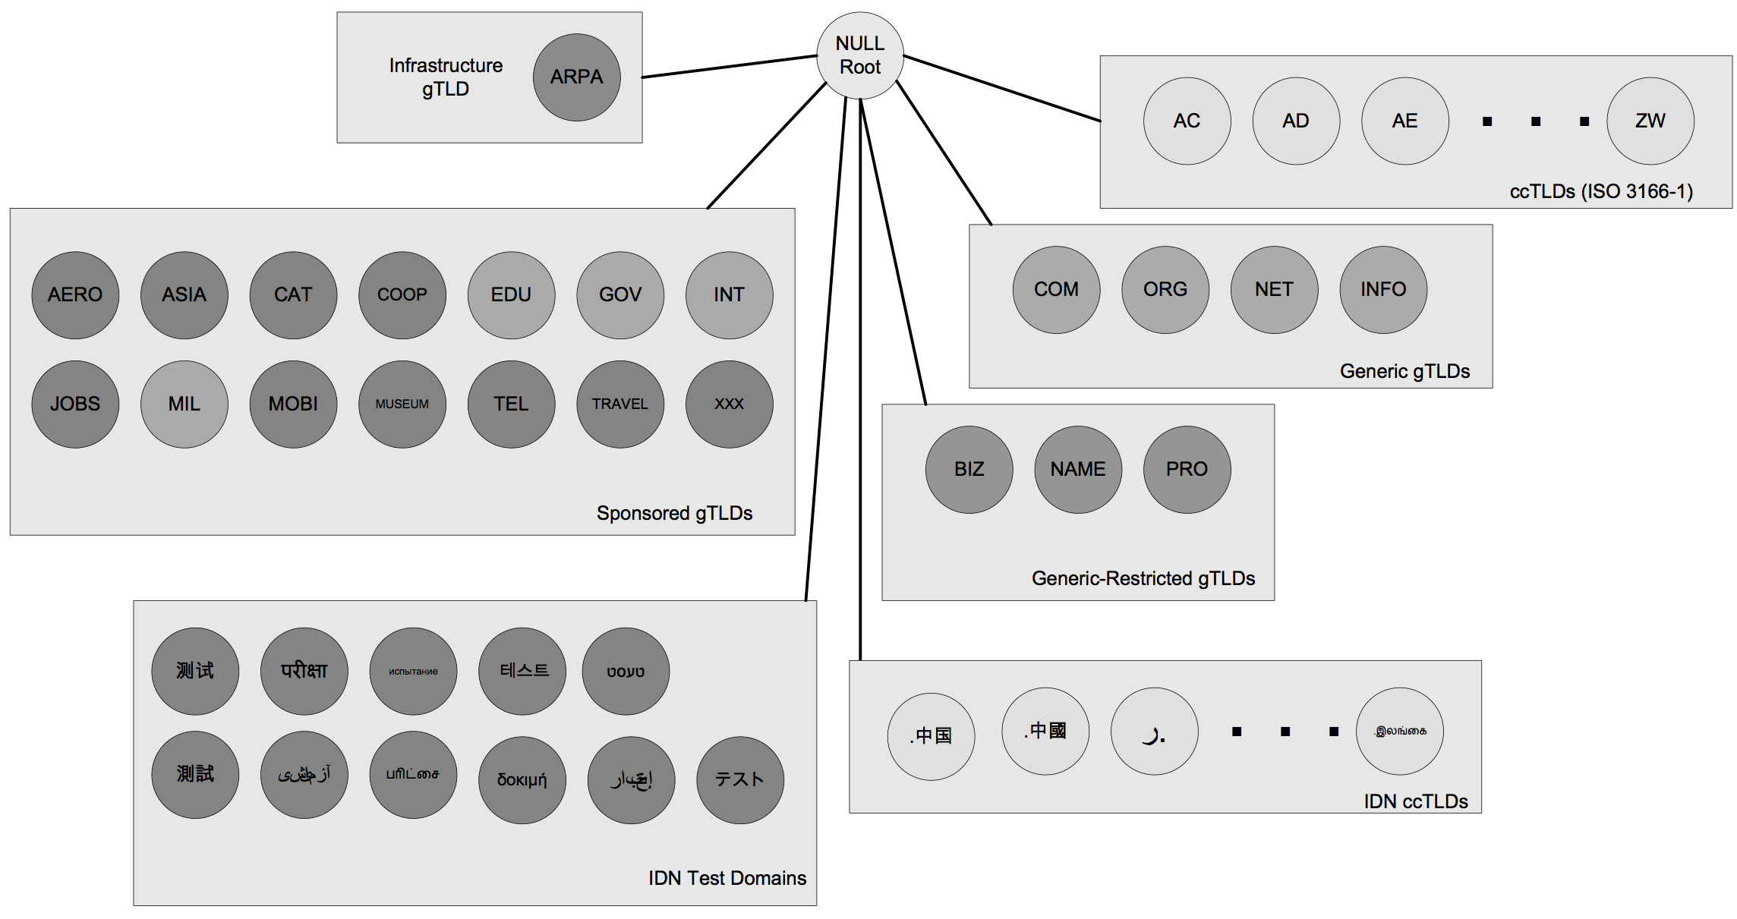
Top Domains

Slide 35
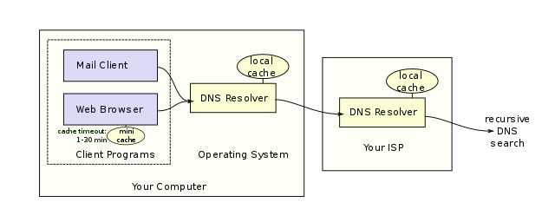
Resolving
int inet_pton(int family, const char *strptr, void *addptr);
const char *inet_ntop(int family, const struct *addrptr, char *strptr, size_t len);

Slide 36
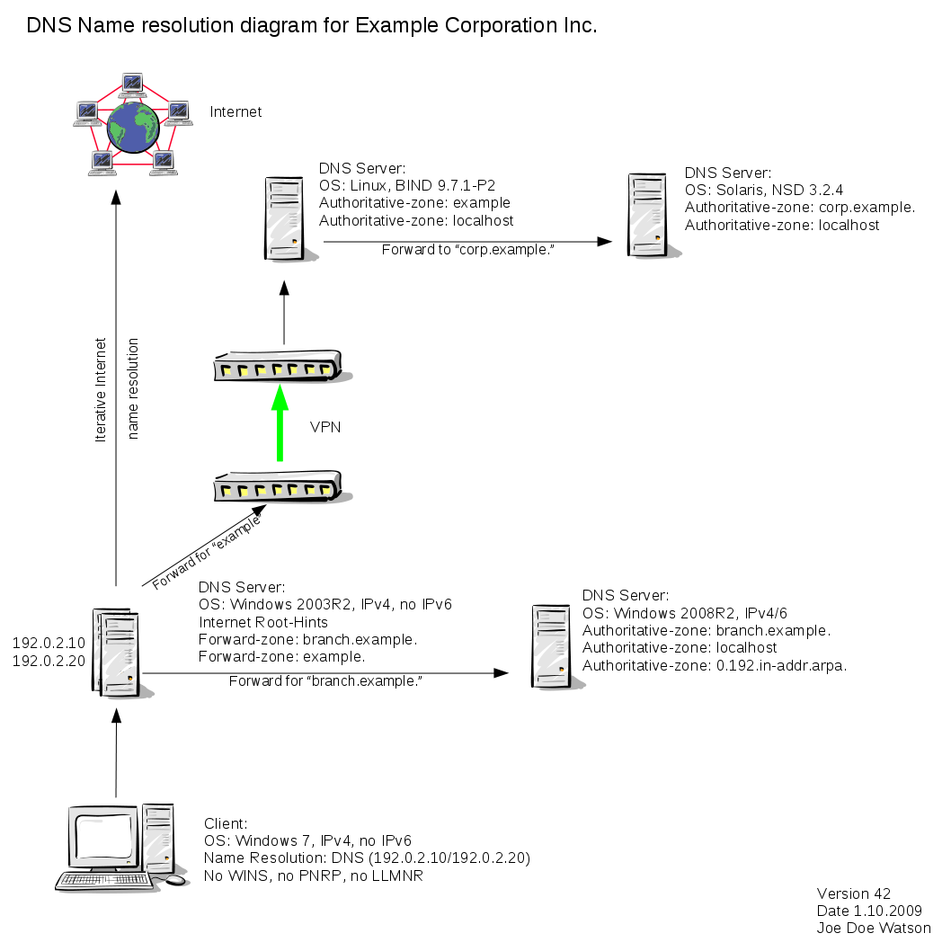
Resolving(2)

Slide 37
Resolving(3)

Slide 38
Resolving(4)

Slide 39
Read and Write Stream (TCP) Sockets
Different from normal I/O
May read or write less than requested
TCP has a state!

Slide 40
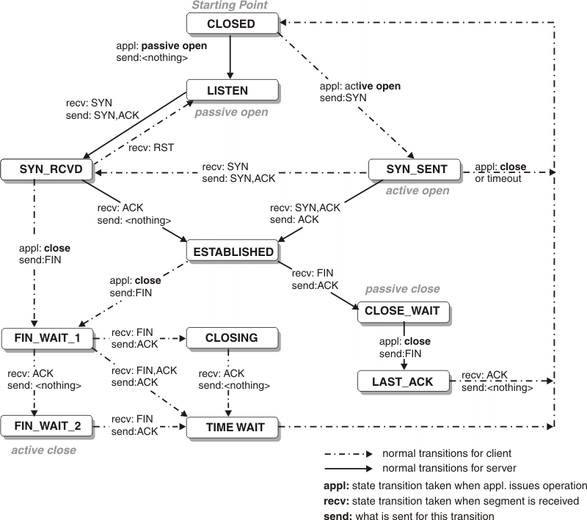
TCP state transition diagram

Slide 41


Tools
Tcpdump // Wireshark | tshark
See what’s on the wire/network ---this is the baseline---
netcat || nc
Swiss army knife for networking ☺
Supports UDP and TCP
Can act as server or client

